Slide 1


Slide 2
Weekly Updates
Please provide a quick update on either:
Something you did/saw this week that you thought was interesting
What you’re looking forward to about this week’s workshop
(Reminder - please have your cameras on if possible)

Slide 3
Workshop 5
Model Training Approaches

Slide 4

Recap

Slide 5
Sessions Overview
Workshop 1 – Project Introduction & Setup
Workshop 2 – Genomic Data (A2 Assignment)
Workshop 3 – Data Analysis & Visualization (A3 Assignment)
Workshop 4 – Featurization & Baseline Modeling (A4 Assignment)
Workshop 5 – Model Training Approaches (Final Assignment Set)
Workshop 6 – Model Tuning
Workshop 7 – Performance Evaluation (Final Assignment Code/Testing Due)
Workshop 8 – Results Presentation & Wrap up (Final Presentation Due)

Slide 6
The Data Science Process
Understand the Problem
Gather Data
Explore & Analyze Data
Repeat as needed:
Data Science is an iterative process
Featurize Data
Model Building
Evaluate and Compare
Present Results

Slide 7
From Features to Models
Last week we explored a number of featurization methods
3 possible feature spaces to leverage for modeling
Opportunity to expand further
Assignment 4 - already built a simple model
What comes next?
Review modeling options
Relate models to feature options
Determine a robust framework for training models

Slide 8
Model Types

Slide 9
Linear Models
Continuous Linear Model
y
Binary S vs R targets
Good starting point
Examples:
Regression
Linear
Logistic
SVM
Assumptions:
Linear relationships
Is this expected from our data?
Presence/Absence
Kmers
Sequences
x
Presence Absence Binary Model
y
R
?
S
x
Absent
Present

Slide 10
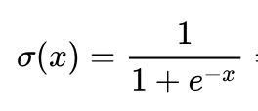
Logistic Regression
Logistic Model
y
R
Simple Linear regression won’t work for us
Target is binary & Features = binary or counts
Overview:
Logistic regression = GLM
Link function
Mapping from continuous to bounded
Sigmoid function
Python:
Sklearn.linear_model
Documentation
S
x
Presence Absence Binary Model
y
R
y = “predicted probability”
S
x
Absent
Present

Slide 11
Tree Based Models
Decision Tree
A < 5
Decision Trees
Random Forest (Ensemble)
Decision Trees:
Non-linear modeling approach
Based off stacking binary decisions
Natural fit for our presence/absence features
Decision trees rarely used alone
Random Forest:
Ensemble = combine multiple models
Leverages Bagging (Bootstrap aggregating)
Python:
Sklearn.ensemble
Documentation
C < 0.5
B < 0.5
Tree Depth
A < 3
Process:
Decide on which feature to split (gain)
Determine a splitting threshold
Continue splitting until stop criteria (e.g. maximum depth)
Inference:
New sample traverses tree
Ends up at a single “leaf node”
Take average value from leaf

Slide 12
Tree Based Models
Bagging = Repeatedly sample with replacement
Dataset
Decision Trees
Random Forest (Ensemble)
Decision Trees:
Non-linear modeling approach
Based off stacking binary decisions
Natural fit for our presence/absence features
Decision trees rarely used alone
Random Forest:
Ensemble = combine multiple models
Leverages Bagging (Bootstrap aggregating)
Python:
Sklearn.ensemble
Documentation
Sample1
Sample2
Sample3

Slide 13
Tree Based Models
Bagging = Repeatedly sample with replacement
Dataset
Decision Trees
Random Forest (Ensemble)
Decision Trees:
Non-linear modeling approach
Based off stacking binary decisions
Natural fit for our presence/absence features
Decision trees rarely used alone
Random Forest:
Ensemble = combine multiple models
Leverages Bagging (Bootstrap aggregating)
Python:
Sklearn.ensemble
Documentation
Sample1
Sample2
Sample3
Random Forest = Build New Tree per Bag

Slide 14
Tree Based Models
Bagging = Repeatedly sample with replacement
Dataset
Decision Trees
Random Forest (Ensemble)
Decision Trees:
Non-linear modeling approach
Based off stacking binary decisions
Natural fit for our presence/absence features
Decision trees rarely used alone
Random Forest:
Ensemble = combine multiple models
Leverages Bagging (Bootstrap aggregating)
Python:
Sklearn.ensemble
Documentation
Sample1
Sample2
Sample3
Random Forest = Build New Tree per Bag
Prediction = Each Sample passes through each Tree
Output = Average across trees

Slide 15
Gradient Boosting
y
Ensemble method
Can use any underlying model
Common to use decision trees
Overview:
Iteratively fit models on residuals of the previous
Learn from the mistakes of the last model
Leveraging lots of simple models
Options:
Sklearn Gradient Boosting
LightGBM
XGBoost
x

Slide 16
Gradient Boosting
y
Ensemble method
Can use any underlying model
Common to use decision trees
Overview:
Iteratively fit models on residuals of the previous
Learn from the mistakes of the last model
Leveraging lots of simple models
Options:
Sklearn Gradient Boosting
LightGBM
XGBoost
Mean Prediction is base model
x
y
Calculate Residuals
x

Slide 17
Gradient Boosting
y
Ensemble method
Can use any underlying model
Common to use decision trees
Overview:
Iteratively fit models on residuals of the previous
Learn from the mistakes of the last model
Leveraging lots of simple models
Options:
Sklearn Gradient Boosting
LightGBM
XGBoost
Calculate Residuals
x
y
Learning rate limits step size
Fit next model to residuals
x

Slide 18
Neural Networks
Single Neuron
x1
Many different architectures
Convolutional Neural Network (CNN)
Recurrent Neural Network (RNN)
Tabular & Sequence data (e.g. audio/image)
Overview:
Very powerful and flexible
Expensive to train & can overfit easily
Network of simple nonlinear functions
Options:
Tensorflow
Keras (higher level interface)
Pytorch
Sum
y
x2
y = x1 + x2

Slide 19
Neural Networks
Single Neuron
x1
w1
Many different architectures
Convolutional Neural Network (CNN)
Recurrent Neural Network (RNN)
Tabular & Sequence data (e.g. audio/image)
Overview:
Very powerful and flexible
Expensive to train & can overfit easily
Network of simple nonlinear functions
Options:
Tensorflow
Keras (higher level interface)
Pytorch
Sum
y
w2
x2
y = w1x1 + w2x2

Slide 20
Neural Networks
Single Neuron
bias
x1
w1
Many different architectures
Convolutional Neural Network (CNN)
Recurrent Neural Network (RNN)
Tabular & Sequence data (e.g. audio/image)
Overview:
Very powerful and flexible
Expensive to train & can overfit easily
Network of simple nonlinear functions
Options:
Tensorflow
Keras (higher level interface)
Pytorch
Sum
y
w2
x2
y = w1x1 + w2x2 + b

Slide 21
Neural Networks
Single Neuron
bias
x1
w1
Many different architectures
Convolutional Neural Network (CNN)
Recurrent Neural Network (RNN)
Tabular & Sequence data (e.g. audio/image)
Overview:
Very powerful and flexible
Expensive to train & can overfit easily
Network of simple nonlinear functions
Options:
Tensorflow
Keras (higher level interface)
Pytorch
Non-linear f()
Sum
y
w2
x2
y = f( w1x1 + w2x2 + b )

Slide 22
Neural Networks
Single Neuron
bias
x1
w1
Many different architectures
Convolutional Neural Network (CNN)
Recurrent Neural Network (RNN)
Tabular & Sequence data (e.g. audio/image)
Overview:
Very powerful and flexible
Expensive to train & can overfit easily
Network of simple nonlinear functions
Options:
Tensorflow
Keras (higher level interface)
Pytorch
Non-linear f()
Sum
y
w2
x2
y = f( w1x1 + w2x2 + b )
Neural Network
Each line is a weight (biases not shown)
x1
y
x2
y = f( f() + f() + … )

Slide 23
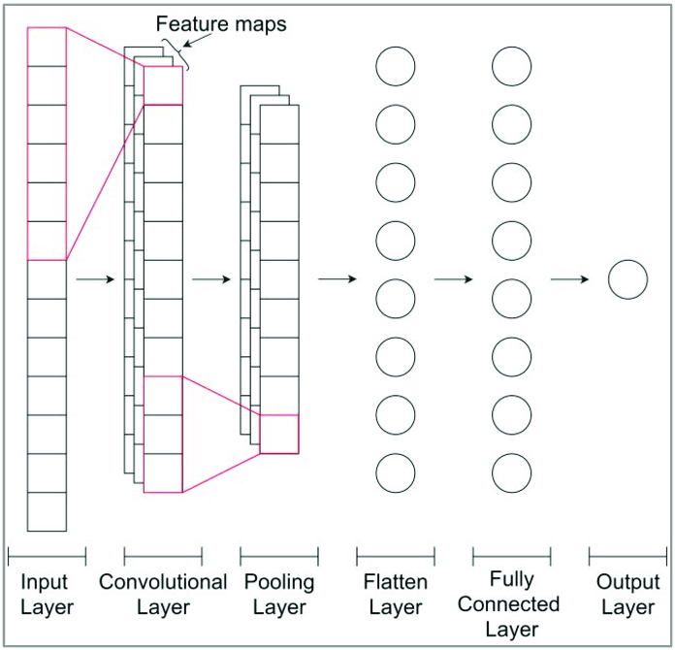
Neural Networks
Convolutional (1D) Neural Network
Many different architectures
Convolutional Neural Network (CNN)
Recurrent Neural Network (RNN)
Tabular & Sequence data (e.g. audio/image)
Overview:
Very powerful and flexible
Expensive to train & can overfit easily
Network of simple nonlinear functions
Options:
Tensorflow
Keras (higher level interface)
Pytorch
[1]

Slide 24
QUIZ TIME !?
Which model would you try first and why?
Convolutional neural network
Decision tree
Logistic regression
Random forest
Gradient boosted trees

Slide 25
Model Training

Slide 26
Data Splitting - Cross validation
Cross validation is a fundamental concept for training ML models:
Training a single model is risky
Wish to train many models to study uncertainty
Standard splitting method: K-fold
Process:
Shuffle your data
Split the data into 1/K chunks
Iteratively split 1/K to validate and (K-1)/K to train
Each samples appears in validate exactly once
Note: separate from having a completely held out test set
Dataset

Slide 27
Data Splitting - Cross validation
Cross validation is a fundamental concept for training ML models:
Training a single model is risky
Wish to train many models to study uncertainty
Standard splitting method: K-fold
Process:
Shuffle your data
Split the data into 1/K chunks
Iteratively split 1/K to validate and (K-1)/K to train
Each samples appears in validate exactly once
Note: separate from having a completely held out test set
Dataset
Shuffle ordering

Slide 28
Data Splitting - Cross validation
Cross validation is a fundamental concept for training ML models:
Training a single model is risky
Wish to train many models to study uncertainty
Standard splitting method: K-fold
Process:
Shuffle your data
Split the data into 1/K chunks
Iteratively split 1/K to validate and (K-1)/K to train
Each samples appears in validate exactly once
Note: separate from having a completely held out test set
Say K = 3
Split the Data into 3 chunks

Slide 29
Data Splitting - Cross validation
Cross validation is a fundamental concept for training ML models:
Training a single model is risky
Wish to train many models to study uncertainty
Standard splitting method: K-fold
Process:
Shuffle your data
Split the data into 1/K chunks
Iteratively split 1/K to validate and (K-1)/K to train
Each samples appears in validate exactly once
Note: separate from having a completely held out test set
Say K = 3
Split the Data into 3 chunks
Validate
Assign 1/3 to Validate
Train
Assign 2/3 to Train

Slide 30
Data Splitting - Cross validation
Cross validation is a fundamental concept for training ML models:
Training a single model is risky
Wish to train many models to study uncertainty
Standard splitting method: K-fold
Process:
Shuffle your data
Split the data into 1/K chunks
Iteratively split 1/K to validate and (K-1)/K to train
Each samples appears in validate exactly once
Note: separate from having a completely held out test set
Say K = 3
Split the Data into 3 chunks
Repeat 3 times to make 3 datasets
(Orange box = Validate)

Slide 31
Final Project

Slide 32
Final Project - Overview
Challenge: Build the best model you can to Predict Cefepime S vs R in Escherichia coli
Requirements
Use any feature sets
Try at least two models
Use CV
Tune model to optimize performance
Evaluate and discuss model performance
Future weeks will cover tuning and evaluation in more detail

Slide 33
Final Project - Evaluation
Challenge: Build the best model you can to Predict Cefepime S vs R in Escherichia coli
Evaluation
Not being scored based on model performance
Should be able to get good (>90% accuracy) performance using simple models + features
Clear and well documented code
Well specified and trained model
Discussion and presentation of results
Submission:
Results Notebook (can include .py file as desired)
Summary slides (5-10 slide max, 5 minute run through)

Slide 34
Final Project - Evaluation
Challenge: Build the best model you can to Predict Cefepime S vs R in Escherichia coli
https://www.kaggle.com/t/e4838697a45d4d1dac9dfca2fe16d687
Join using the link above!
This should be very lightweight and happy to answer any questions about using the page

Slide 35
Workshop 5
Model Building

Slide 36
References
[1]:https://www.researchgate.net/figure/One-dimensional-convolutional-neural-network-1D-CNN-architecture-for-the-timeseries_fig2_348502722

